Slide 1
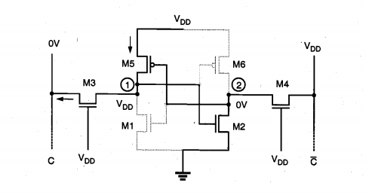
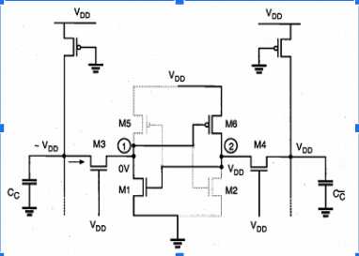
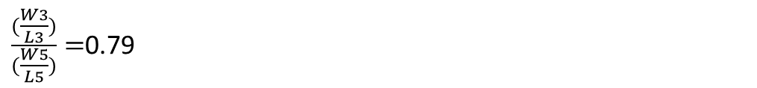


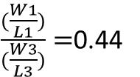
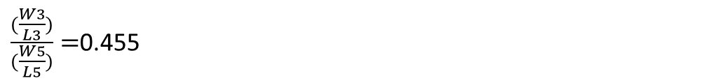
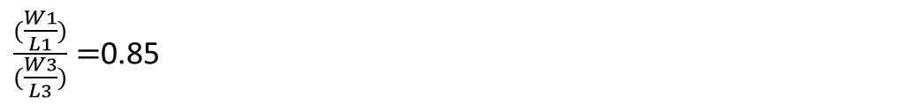
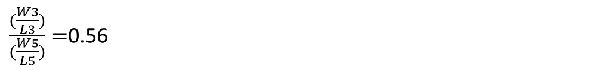
READ(Q=0)
WRITE(Q=1 to 0)
For 0.5v
For 0.5V
$Ids1=Ids3$
$\frac{k}{2}\left[2\left(Vgs−Vt\right)Vdd−Vds^{2}\right]=\frac{k}{2}{\left(Vgs−Vt\right)}^{2}$
$\frac{(\frac{W1}{L1})}{(\frac{W3}{L3})}=3.77$
$$\frac{(\frac{W1}{L1})}{(\frac{W3}{L3})}=1.53$$
$Ids3=Ids5$
$\frac{k}{2}\left[2\left(Vgs−Vt\right)Vds−Vds^{2}\right]=\frac{1}{2}{ μp Cox (\frac{W5}{L5})\left(Vsg−|Vt|\right)}^{2}$
$μn \left(\frac{W3}{L3}\right)\left[2\left(Vgs−Vt\right)Vds−Vds^{2}\right]$=$μp\left(\frac{W5}{L5}\right){\left(Vsg−\left|Vt\right|\right)}^{2}$
$\frac{(\frac{W3}{L3})}{(\frac{W5}{L5})}=$1.5
For 1V
For 1.5v
For 1V
$\frac{(\frac{W1}{L1})}{(\frac{W3}{L3})}=$0.85
$\frac{(\frac{W3}{L3})}{(\frac{W5}{L5})}=$0.79
M5=Saturation region, M3=Linear region
For 2V
For 1.5V
For 2V
$\frac{(\frac{W1}{L1})}{(\frac{W3}{L3})}=$0.44
M1=Linear region ,M3=Saturation region
$\frac{(\frac{W3}{L3})}{(\frac{W5}{L5})}=$0.455
$\frac{(\frac{W3}{L3})}{(\frac{W5}{L5})}=$0.56
Taking W5=0.6 and L5=0.4
0.5V
1V
1.5V
2V
2.5V
W1=3.39 L1=0.4
W1=0.7 L1=0.4
W1=0.6 L1=0.84
W1=0.6 L1=2
W1=0.6 L1=4.61
W3=0.9 L3=0.4
W3=0.6 L3=0.5
W3=0.6 L3=0.7
W3=0.6 L3=0.88
W3=0.6 L3=1.03

